Slide 1







Inquirers
We nurture our curiosity, developing skills for inquiry and research. We know how to learn independently and with others. We learn with enthusiasm and sustain our love of learning throughout life.
What activities will help you to become more inquiring?
Coding
STEM Club
Science Competitions
Lego Robotics and Vex
Photography
Vietnamese Cultural Heritage
Design Technology clinic
Bright Minds Lounge
Powers of CAD – 3D design
Mandarin / Korean
Newspaper
Book club

Slide 2
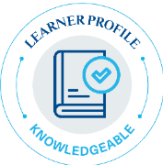



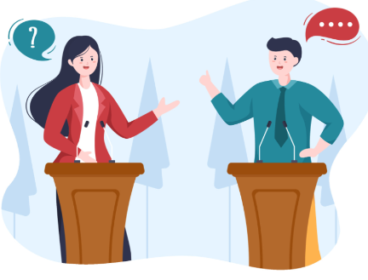
Knowledgeable
We develop and use conceptual understanding, exploring knowledge across a range of disciplines. We engage with issues and ideas that have local and global significance.
What activities will help you to become more knowledgeable?
Mandarin / Korean
Coding
Debate
Business Club / Competition
Design Technology Clinic
Vietnamese Cultural Heritage
Homework club
Stem Club
Bright Minds
Maths support
Book club
Model United Nations
Lego Robotics and VEX VR

Slide 3
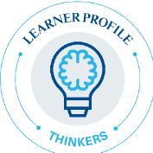




Thinkers
We use critical and creative thinking skills to analyse and take responsible action on complex problems. We exercise initiative in making reasoned, ethical decisions.
What activities will help you to become better thinkers?
Coding
Chess
Dungeons and Dragons
Debate
Newspapers
Strategic Games
Board Games
Bright Minds Lounge
Young Voices
Model United Nations
Film Critique
Powers of CAD – 3D Design
Music composition

Slide 4
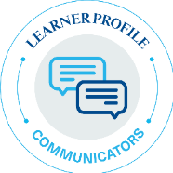



Communicators
We express ourselves confidently and creatively in more than one language and in many ways. We collaborate effectively, listening carefully to the perspective of other individuals and groups.
What activities will help you to become better communicators?
Public speaking
Debate
Model United Nations
Volleyball, pickleball, rugby, football
Newspaper
Senior Choir
Reading Leaders
Mandarin / Korean
Dungeons and Dragons
Volunteering in Prep
Board Games
EAL support
Theatre Production

Slide 5
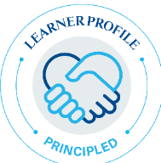


Principled
We act with integrity and honesty, with a strong sense of fairness and justice, and with respect for the dignity and rights of people everywhere. We take responsibility for our actions and their consequences.
What activities will help you to become more principled?
Community Support
Animal Welfare and Community Action
Volunteering in Prep
Homework club
Newspaper
Board Games
Model United Nations
Reading Leaders
Rugby / Football / Basketball / Athletics / Golf

Slide 6
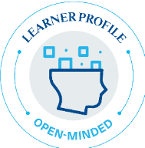


Open-minded
We critically appreciate our own cultures and personal histories, as well as the values and traditions of others. We seek and evaluate a range of points of view, and we are willing to grow from the experience.
What activities will help you to become more open-minded?
Mandarin / Korean
Dungeons and Dragons
Debate
Bright Minds Lounge
Meditation and Mindfulness
Model United Nations
Book Club
Senior Choir
Film critique
Set Design / Costume Design
Art Projects
Young Voices
Theatre Production

Slide 7
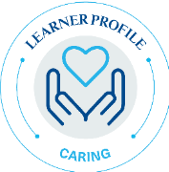
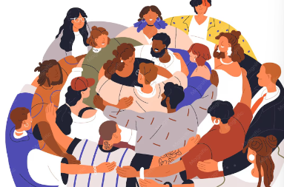


Caring
We show empathy, compassion and respect. We have a commitment to service, and we act to make a positive difference in the lives of others and in the world around us.
What activities will help you to become more caring?
Community support
Volunteering in Prep
Homework club
Animal Welfare and Community Action
Reading Leaders
EAL support
Maths support

Slide 8
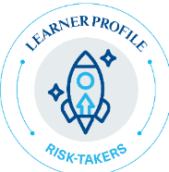


Risk-takers
We approach uncertainty with forethought and determination; we work independently and cooperatively to explore new ideas and innovative strategies. We are resourceful and resilient in the face of challenges and change.
What activities will help you to become greater risk-takers?
Badminton / Volley ball / Pickleball / Table Tennis / Rugby /Football / Basketball / Athletics / Swim squad
Business Competition
Public Speaking
Senior Choir
Chess
Strategic Games
Theatre Production
Art Projects
Music composition

Slide 9
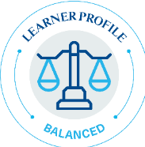



Balanced
We understand the importance of balancing different aspects of our lives – intellectual, physical, and emotional – to achieve well-being for ourselves and others. We recognise our interdependence with other people and with the world in which we live.
What activities will help you to become more balanced?
Badminton / Volleyball / Pickleball/ Table Tennis / Rugby / Football / Basketball / Darts / Swim squad / Athletics / Golf
Board Games
Electric Guitar
Senior Choir
String Ensemble
Baking / Cooking
Meditation and Mindfulness
Knitting
School of Rock
Theatre Production
Ceilidh / Folk Band

Slide 10
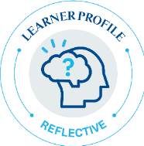

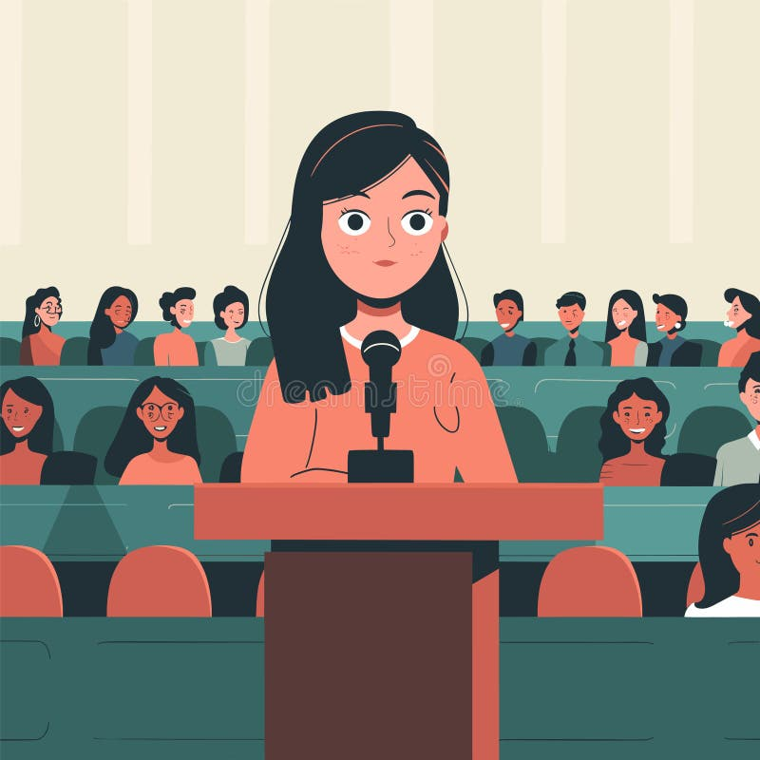
Reflective
We thoughtfully consider the world and our own ideas and experience. We work to understand our strengths and weaknesses in order to support our learning and personal development.
What activities will help you to become more reflective?
Public speaking
Volunteering in Prep
Meditation and Mindfulness
Strategic Games
Animal Welfare and Community Action
Book Club
Film Critique
Photography
Young Voices
Bright Minds
Art Projects
Music Composition
Costume Design

