Slide 1




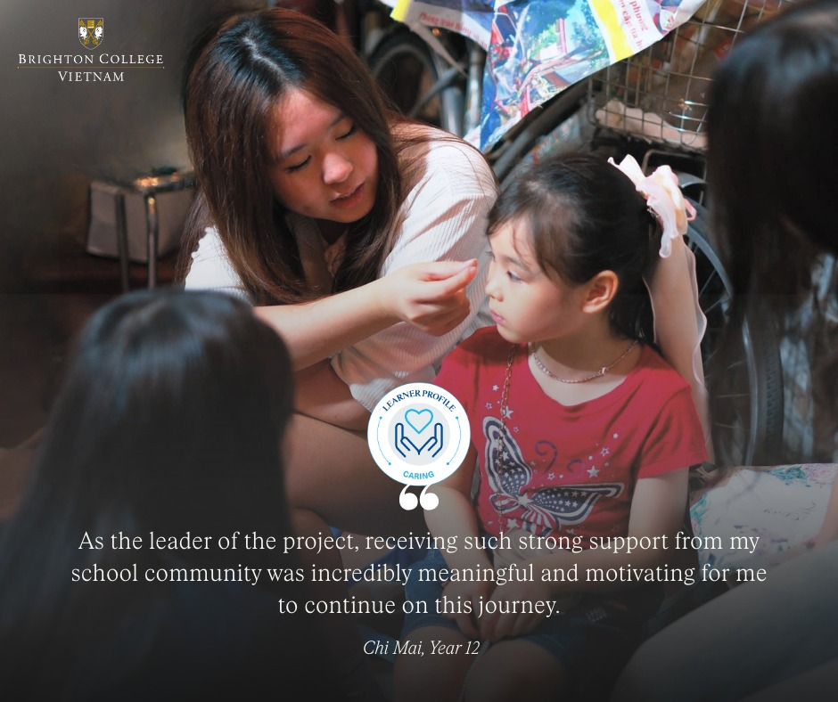

CAS: Learning Outcomes
Developing challenging programmes of international education and rigorous assessment

Slide 2

What is CAS?
CAS is one of the three core elements of the IB Diploma. It is designed to help you grow beyond the classroom by developing new skills, discovering your strengths and making a positive difference to others.
CAS is built around three strands:
Over the next 18 months, CAS will encourage you to step outside your comfort zone, try new experiences, reflect on your learning and become a more confident, balanced and compassionate person.
Throughout your journey, you will record your experiences and reflections in your ManageBac CAS Portfolio, creating a record of your growth and achievements. Successfully completing CAS is a requirement for earning the IB Diploma—but more importantly, it is an opportunity to discover who you are and who you want to become.

Slide 3
What is CAS?
Look at the following experiences. Which of these do you think are examples of CAS and which are not?
Phuoc learns to kayak for the first time and reflects on becoming more confident around water. | Gia Bao has played club football for ten years and continues attending weekly training sessions exactly as he always has. | Phuong Uyen organizes a school fundraiser for a local animal shelter, leading a team of volunteers from planning to delivery. | Xuan Bach watches his younger brother after school every day because his parents are at work. | Hanna teachers herself conversational Vietnamese so she can communicate more confidently with members of the local community.
Mimi binge-watches a documentary series about climate change during the holidays. | Phuong Vy starts a lunchtime chess club for younger students and adapts sessions after collecting feedback. | Le Dung spends Saturday morning playing video games with friends online. | Gia Hung volunteers monthly at a local food bank and reflects on what he learns about food insecurity. | Tue San attends her weekly piano lesson, preparing for her Grade 8 exam as she has done for several years.

Slide 4
What is CAS?
Look at the following experiences. Which of these do you think are examples of CAS and which are not?
Phuoc learns to kayak for the first time and reflects on becoming more confident around water. | Gia Bao has played club football for ten years and continues attending weekly training sessions exactly as he always has. | Phuong Uyen organizes a school fundraiser for a local animal shelter, leading a team of volunteers from planning to delivery. | Xuan Bach watches his younger brother after school every day because his parents are at work. | Hanna teachers herself conversational Vietnamese so she can communicate more confidently with members of the local community.
Mimi binge-watches a documentary series about climate change during the holidays. | Phuong Vy starts a lunchtime chess club for younger students and adapts sessions after collecting feedback. | Le Dung spends Saturday morning playing video games with friends online. | Gia Hung volunteers monthly at a local food bank and reflects on what he learns about food insecurity. | Tue San attends her weekly piano lesson, preparing for her Grade 8 exam as she has done for several years.

Slide 5
How do I determine a CAS experience for myself?
The CAS cycle
Notice
Choose
Do
Reflect
Grow
Notice I notice a need I notice an opportunity I notice something I am interested in I notice a problem that needs solving
Choose I decide how I respond.
Do I take action.
Reflect I consider what I have learned about myself and others.
Grow I think about how this experience has changed me.

Slide 6
How do I determine a CAS experience for myself?
The Learning Outcomes
LO1: Identify own strengths and develop areas for growth. | LO2: Demonstrate that challenges have been undertaken, developing new skills in the process. |  | LO3: Demonstrate how to initiate and plan a CAS experience. |  | LO4: Show commitment and perseverance in CAS experiences.
LO5: Demonstrate the skills and recognize the benefits of working collaboratively. | LO6: Demonstrate engagement with issues of global significance. | LO6: Demonstrate engagement with issues of global significance. | LO7: Recognise and consider the ethics of choices and actions. | LO7: Recognise and consider the ethics of choices and actions.
Your CAS programme is determined by the experiences you choose to pursue but they should help you to fulfil the following seven Learning Outcomes.
These outcomes are at the heart of CAS because they encourage you to challenge yourself, reflect on your experiences and grow into a more confident, compassionate and well-rounded individual.
When going through the CAS cycle, your thinking around these outcomes will play a central role to the success of your CAS experience.

Slide 7
CAS experiences and Learning Outcomes:
The Learning Outcome marketplace
Learning to scuba dive | Organise a charity fun run | Direct the school play | Start a debating club | Coach a Year 7 sports team | Take part in a beach clean-up and environmental campaign
Learn conversational Vietnamese | Volunteer at an animal shelter | Create a mental health awareness campaign | Complete the Duke of Edinburgh Award | Organise a student art exhibition for charity | Start a reading club for younger pupils
Around the room you will find a range of possible CAS experiences.
Your challenge is to visit as many experiences as you can.
For each experience:
  Decide which CAS Learning Outcome is best demonstrated.
  Write your chosen Learning Outcome on the sheet.
  Explain why you selected it.
As you move around the room, read the ideas left by other groups.
  Do you agree with their choice?
  Could the experience demonstrate a different Learning Outcome?
  Can one experience demonstrate more than one Learning Outcome?
Be ready to discuss your ideas with the class.

Slide 8
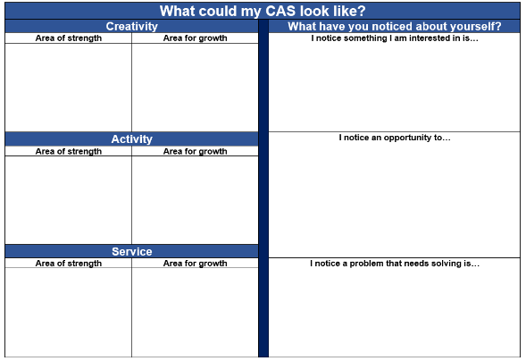
What could my CAS look like?

